Slide 1
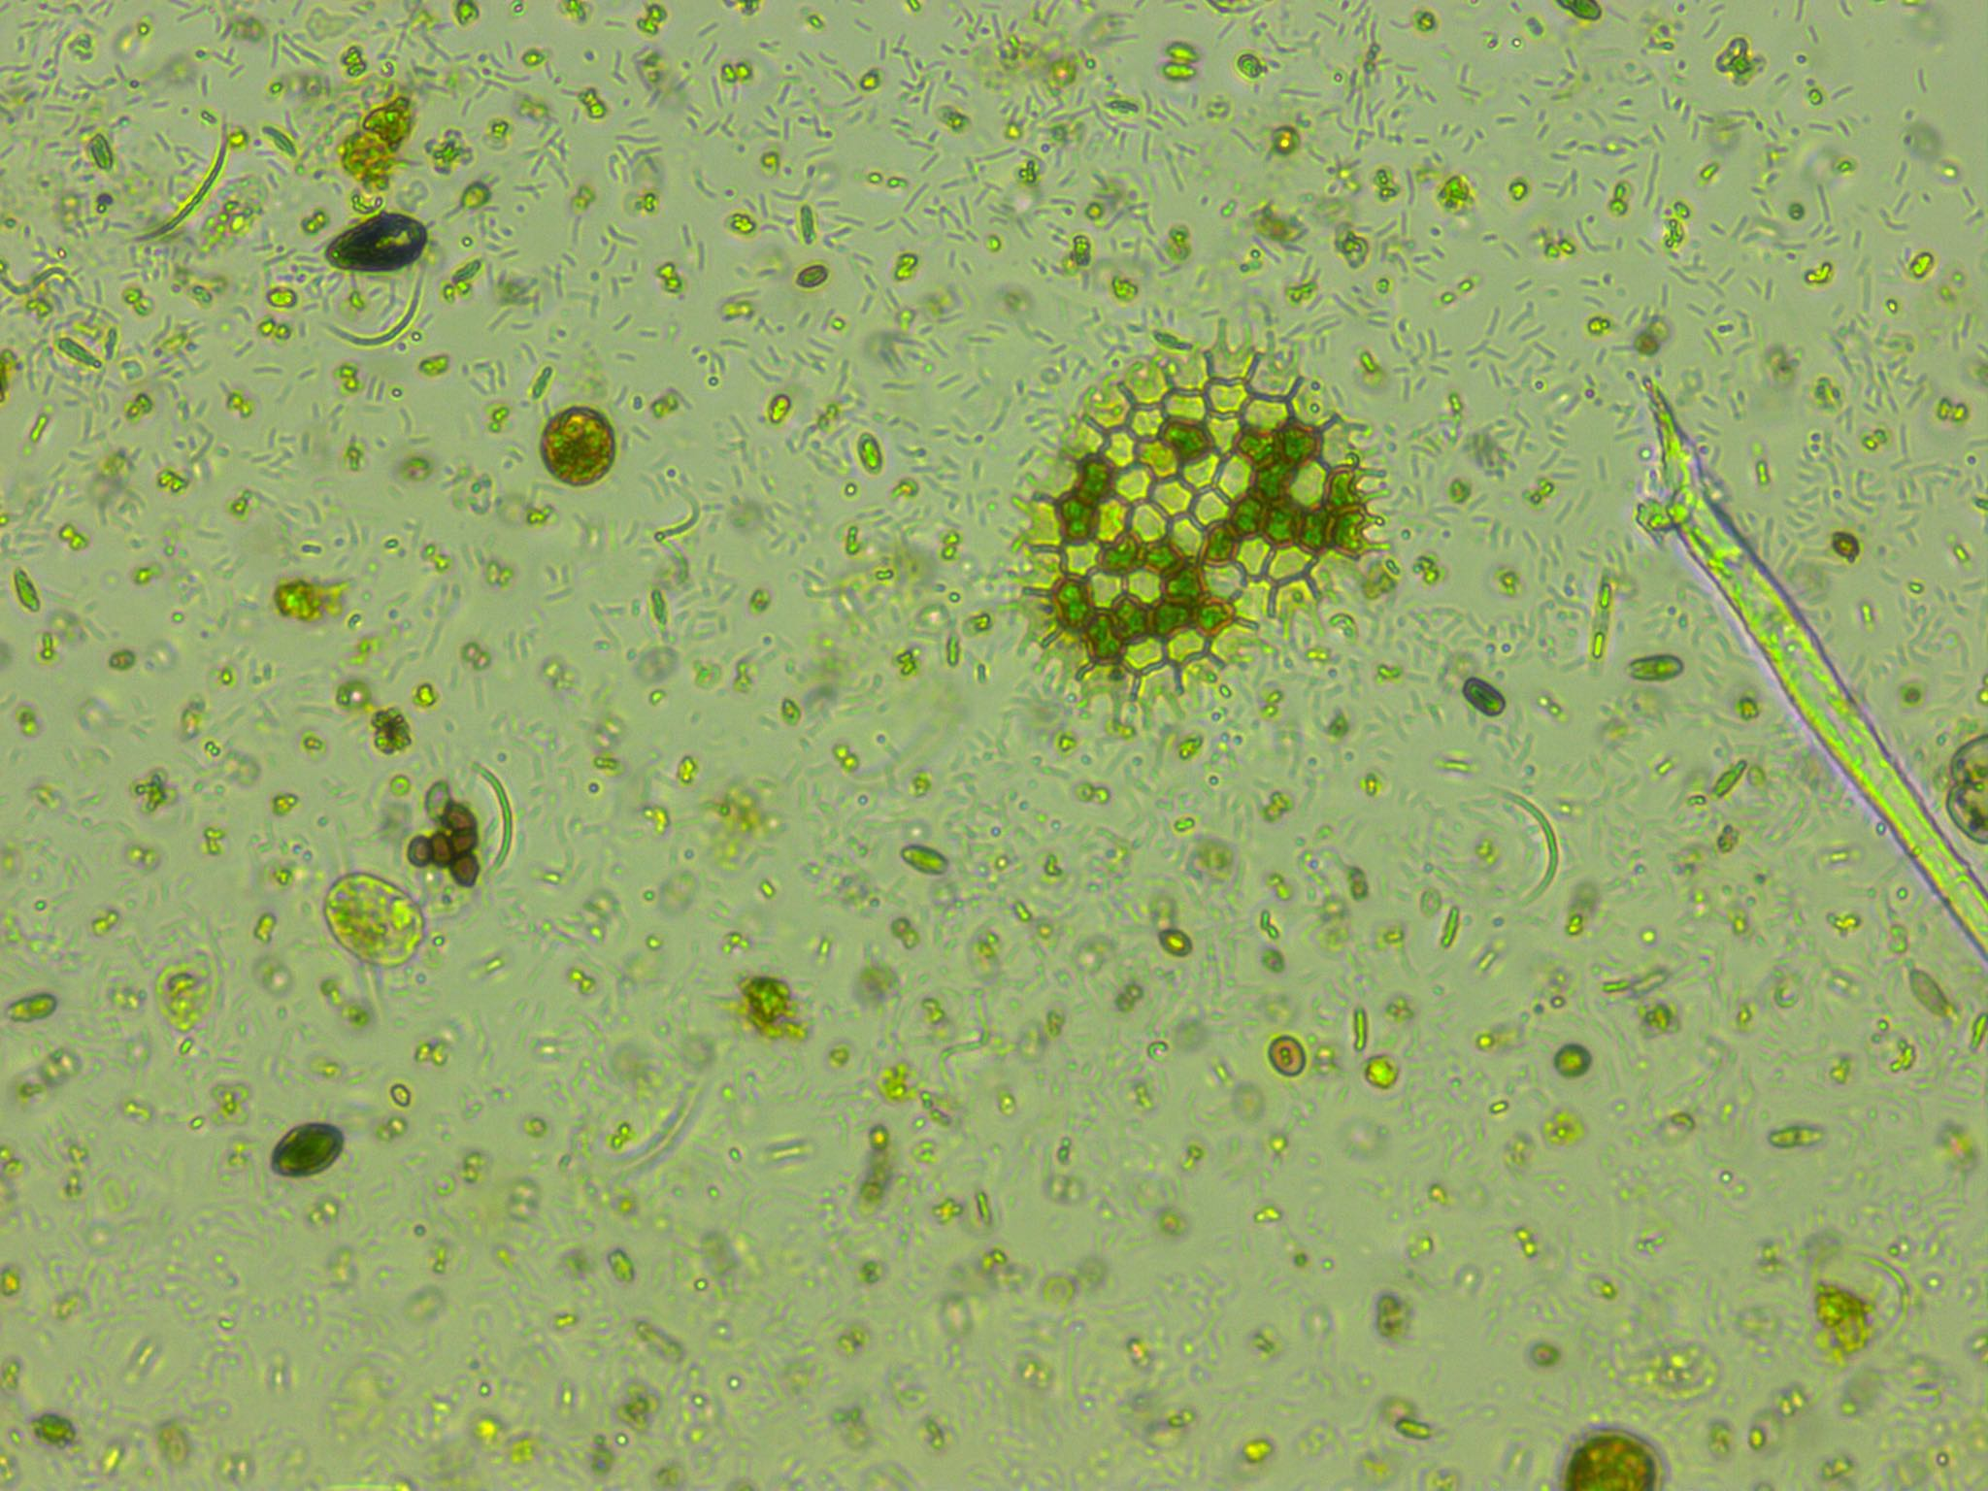
Predicting phytoplankton metabolism from the individual size distribution
Daniel Padfield

Slide 2
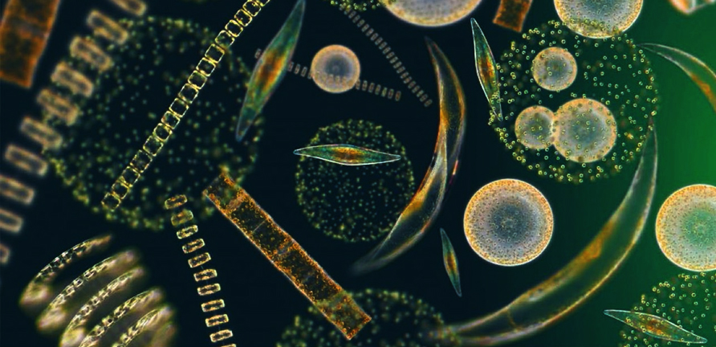
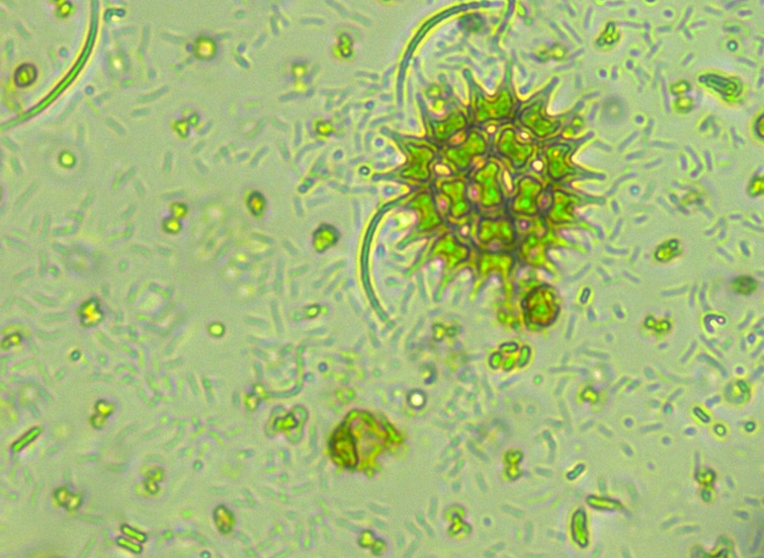
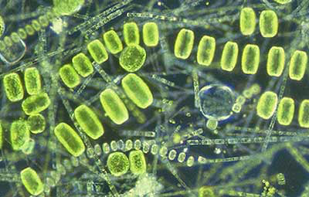
Phytoplankton are key for the carbon cycle
~50% of annual carbon fixation
Fuel entire ocean food webs

Slide 3
Current measurements of metabolism

Slide 4
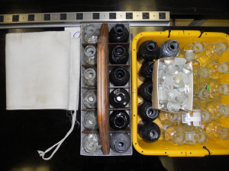
Current measurements of metabolism
Bottle incubations – in vivo
Snapshot in time
Single community
Control over environmental variables

Slide 5
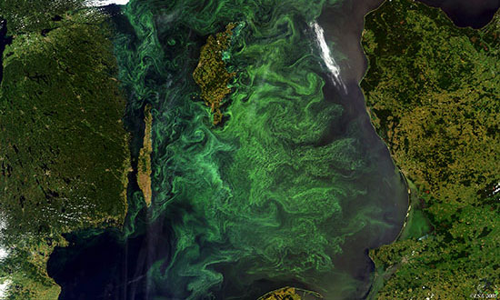
Current measurements of metabolism
Bottle incubations – in vivo
Gas measurements – in situ
Snapshot in time
Single community
Control over environmental variables
Integrates over large areas
Many communities and many different environmental conditions

Slide 6
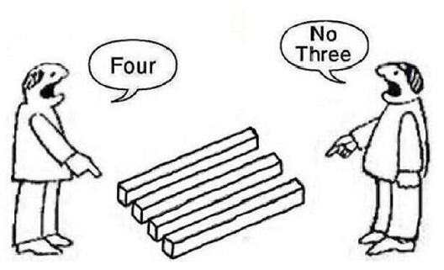
Current measurements of metabolism
Bottle incubations – in vivo
Gas measurements – in situ
Most of the open ocean is net heterotrophic
Most of the open ocean is net autotrophic

Slide 7

Crash course in metabolic theory

Slide 8

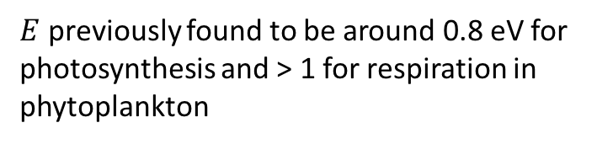
Crash course in metabolic theory
🔥🔥🔥🔥🔥🔥🔥
$$e^{\left.E(\frac{1}{kT_{c}}−\frac{1}{kT}\right)}$$
$E$ previously found to be around 0.8 eV for photosynthesis and > 1 for respiration in phytoplankton

Slide 9
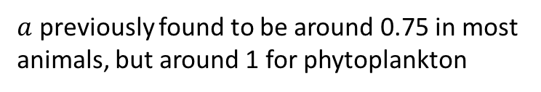

Crash course in metabolic theory
$$m_{i}^{a}$$
$a$ previously found to be around 0.75 in most animals, but around 1 for phytoplankton

Slide 10
Crash course in metabolic theory
$$m_{i}^{a}$$
$a$ previously found to be around 0.75 in most animals, but around 1 for phytoplankton

Slide 11
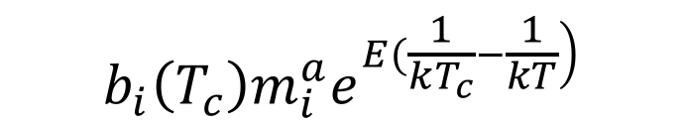
Crash course in metabolic theory
🔥🔥🔥🔥🔥🔥🔥
🔥🔥🔥🔥🔥🔥🔥
$$b_{i}\left(T_{c}\right)m_{i}^{a}e^{\left.E(\frac{1}{kT_{c}}−\frac{1}{kT}\right)}$$

Slide 12
Crash course in metabolic theory
🔥🔥🔥🔥🔥🔥🔥
$$b_{i}\left(T_{c}\right)m_{i}^{a}e^{\left.E(\frac{1}{kT_{c}}−\frac{1}{kT}\right)}$$

Slide 13
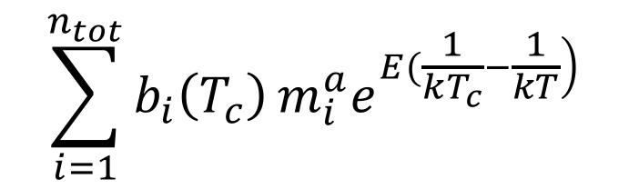
Crash course in metabolic theory
🔥🔥🔥🔥🔥🔥🔥
$$\sum_{i=1}^{n_{tot}}{b_{i}\left(T_{c}\right)}m_{i}^{a}e^{\left.E(\frac{1}{kT_{c}}−\frac{1}{kT}\right)}$$
🔥🔥🔥

Slide 14
Crash course in metabolic theory
🔥🔥🔥🔥🔥
🔥🔥
🔥🔥🔥🔥🔥🔥🔥
$$\sum_{i=1}^{n_{tot}}{b_{i}\left(T_{c}\right)}m_{i}^{a}e^{\left.E(\frac{1}{kT_{c}}−\frac{1}{kT}\right)}$$
🔥🔥🔥
🔥🔥

Slide 15
Crash course in metabolic theory
🔥🔥🔥🔥🔥
🔥🔥
🔥
🔥🔥🔥🔥🔥🔥🔥
🔥🔥🔥🔥🔥🔥🔥🔥
$$\sum_{i=1}^{n_{tot}}{b_{i}\left(T_{c}\right)}m_{i}^{a}e^{\left.E(\frac{1}{kT_{c}}−\frac{1}{kT}\right)}$$
🔥🔥🔥
🔥🔥

Slide 16
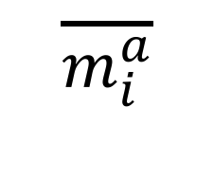
Zero-sum dynamics
$$\overline{m_{i}^{a}}$$

Slide 17
Zero-sum dynamics
🔥🔥🔥
🔥🔥🔥
🔥🔥🔥
🔥🔥🔥
🔥🔥🔥
🔥🔥🔥
🔥🔥🔥
🔥🔥🔥
🔥🔥🔥
$$\overline{m_{i}^{a}}$$

Slide 18
Zero-sum dynamics
$$\overline{m_{i}^{a}}$$

Slide 19
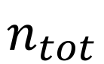
Zero-sum dynamics
$$\overline{m_{i}^{a}}$$
$$n_{tot}$$

Slide 20
Predictions
Can predict metabolism of whole communities from the size- and temperature-dependence of individuals
Across-communities, there will be a trade off between total abundance and average individual metabolic rate
Trade offs mean raw metabolism may be stable across communities

Slide 21
Experimental setup
10 years warming : half 4ºC above ambient

Slide 22
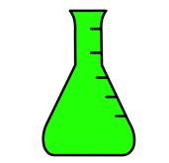
Experimental setup
How do the communities and their functioning change in response to long-term and short-term warming
10 years warming : half 4ºC above ambient
Cool incubator ~ 4 weeks
Warm incubator ~ 4 weeks

Slide 23
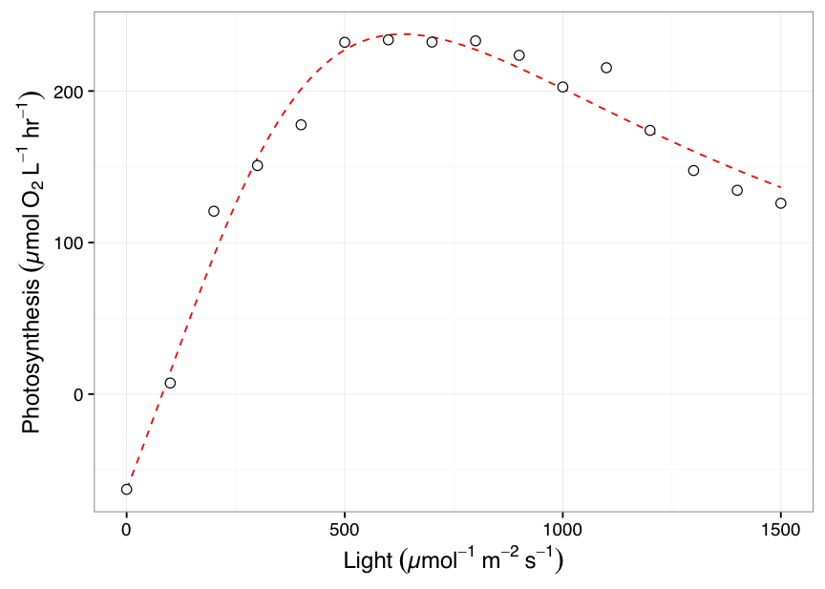
Measurements
+
Metabolism @ incubator temperature
1 point for each microcosm
Size distribution
> 300 points per sample!

Slide 24
Long-term warming changes communities

Slide 25
No difference in measured raw metabolism

Slide 26
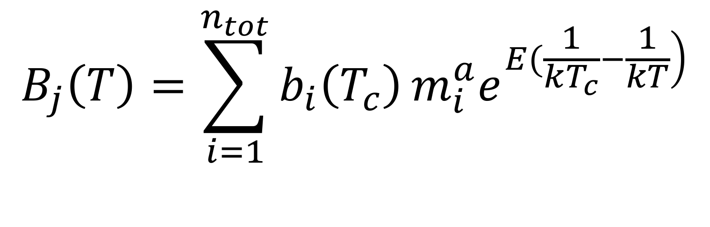
Model
$$B_{j}\left(T\right)=\sum_{i=1}^{n_{tot}}{b_{i}\left(T_{c}\right)}m_{i}^{a}e^{\left.E(\frac{1}{kT_{c}}−\frac{1}{kT}\right)}$$

Slide 27
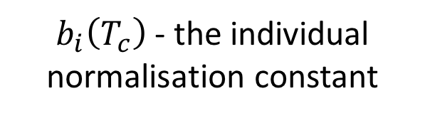
Model
$$B_{j}\left(T\right)=\sum_{i=1}^{n_{tot}}{b_{i}\left(T_{c}\right)}m_{i}^{a}e^{\left.E(\frac{1}{kT_{c}}−\frac{1}{kT}\right)}$$
$b_{i}\left(T_{c}\right)$ - the individual normalisation constant

Slide 28
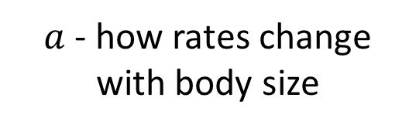
Model
$a$ - how rates change with body size
$$B_{j}\left(T\right)=\sum_{i=1}^{n_{tot}}{b_{i}\left(T_{c}\right)}m_{i}^{a}e^{\left.E(\frac{1}{kT_{c}}−\frac{1}{kT}\right)}$$

Slide 29
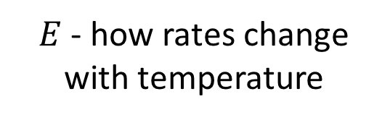
Model
$$B_{j}\left(T\right)=\sum_{i=1}^{n_{tot}}{b_{i}\left(T_{c}\right)}m_{i}^{a}e^{\left.E(\frac{1}{kT_{c}}−\frac{1}{kT}\right)}$$
$E$ - how rates change with temperature

Slide 30
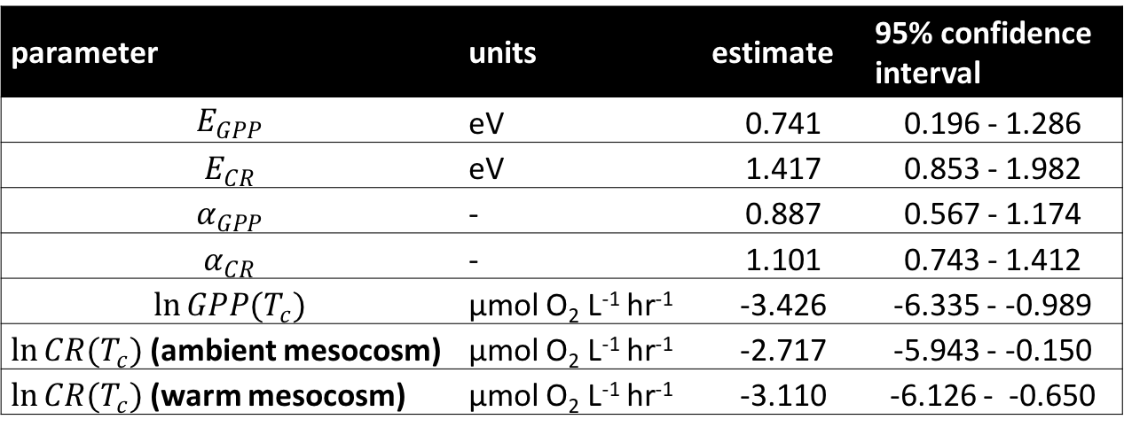
Model predicts size and temperature-dependence
parameter | units | estimate | 95% confidence interval
$$E_{GPP}$$ | eV | 0.741 | 0.196 - 1.286
$$E_{CR}$$ | eV | 1.417 | 0.853 - 1.982
$$α_{GPP}$$ | - | 0.887 | 0.567 - 1.174
$$α_{CR}$$ | - | 1.101 | 0.743 - 1.412
$$\ln{GPP(T_{c})}$$ | µmol O₂ L⁻¹ hr⁻¹ | -3.426 | -6.335 - -0.989
$\ln{CR(T_{c})}$ (ambient mesocosm) | µmol O₂ L⁻¹ hr⁻¹ | -2.717 | -5.943 - -0.150
$\ln{CR(T_{c})}$ (warm mesocosm) | µmol O₂ L⁻¹ hr⁻¹ | -3.110 | -6.126 - -0.650

Slide 31
Predict metabolism
$$B_{j}\left(T\right)=\sum_{i=1}^{n_{tot}}{b_{i}\left(T_{c}\right)}m_{i}^{a}e^{\left.E(\frac{1}{kT_{c}}−\frac{1}{kT}\right)}$$

Slide 32
Model does a pretty good job!

Slide 33
Paradoxical result?

Slide 34
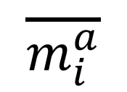
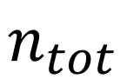
Zero-sum dynamics
$$\overline{m_{i}^{a}}$$
$$n_{tot}$$

Slide 35
Zero-sum dynamics
$$\overline{m_{i}^{a}}$$
$$n_{tot}$$

Slide 36
Zero-sum dynamics
$$\overline{m_{i}^{a}}$$
$$n_{tot}$$

Slide 37
Conclusions
Linked the metabolic rates of whole communities to the individual size distribution
Flow cytometry routinely taken in scientific ship voyages
As a bonus, validated some key assumptions of metabolic scaling theory

Slide 38
Thanks for listening!

